Slide 1
Bazele inteligenței artificiale
Laborator – Grigore Ionuț

Slide 2


today’s lab

Slide 3
Content
Convolutions for images
Padding and stride
Multiple input and multiple output channels
Pooling
LeNet
AlexNet
VGG
Batch Normalization
ResNet

Slide 4
1) Convolutions for images

Slide 5
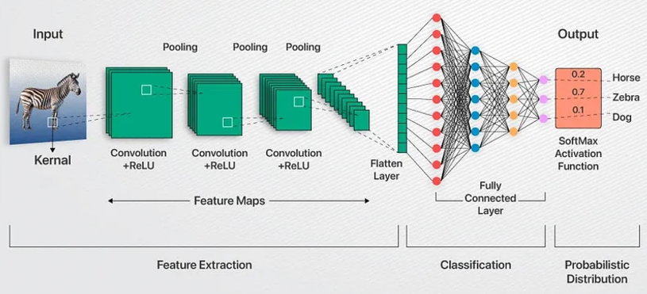








a convolutional neural network (CNN) is a class of neural networks designed specifically for processing image data
A CNN typically includes 3 layers:
  convolutional layers
  pooling layers
  fully-connected layers (from the previous lab)

Slide 6
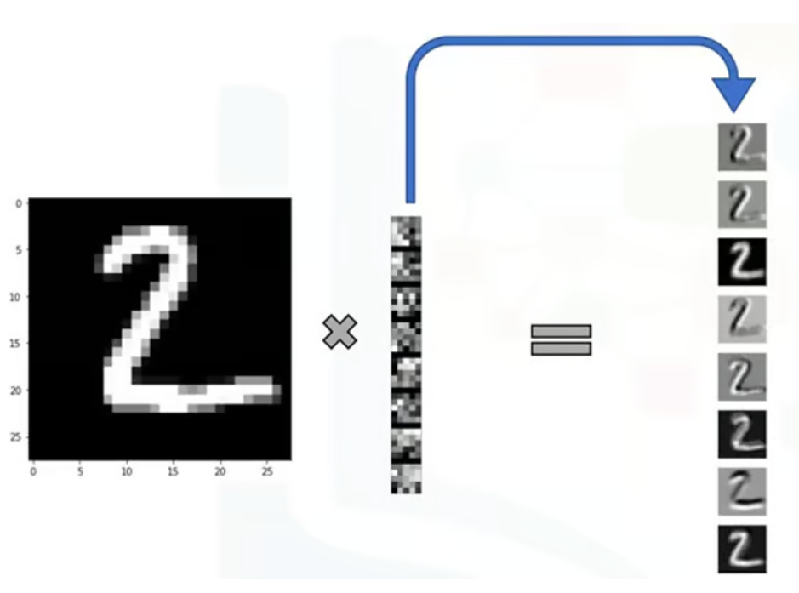
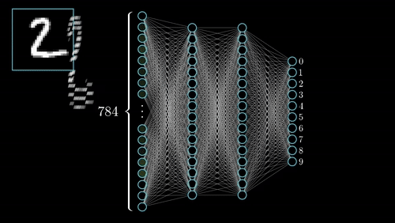
MLP vs CNN

Slide 7
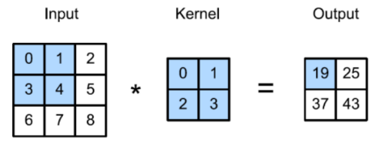
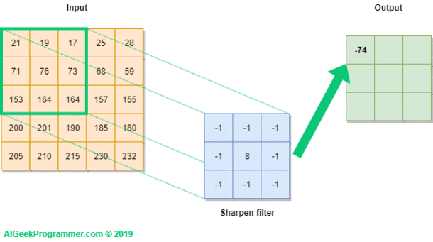


also known as feature map
these are the parameters which CNN learns during training ! ( + a bias which is usually not represented in diagrams)
they are initially random
Kernel

Slide 8
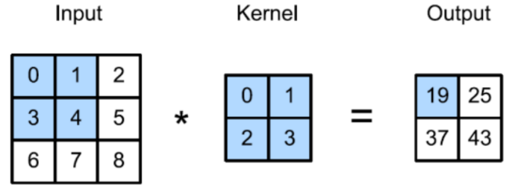
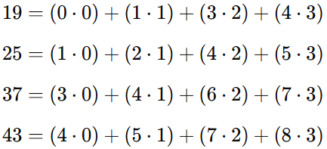
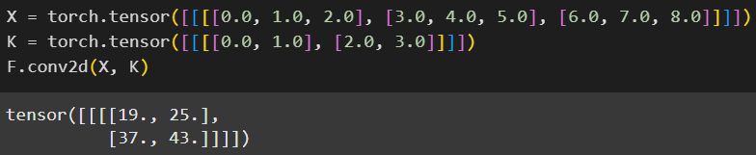

Slide 9
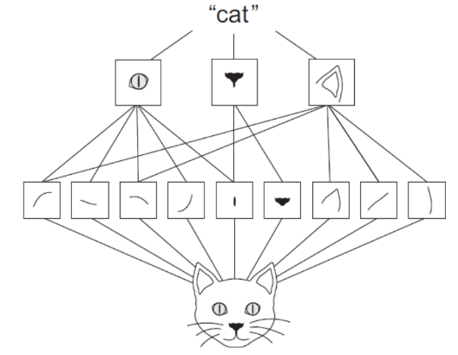
Intuition behind CNNs: a simple example
label prediction
the types of features the kernels are able to detect in the second convolutional layer
the types of features the kernels are able to detect in the first convolutional layer
input image

Slide 10
MLP vs CNN (for images)
Architecture Design
  MLP:
    an MLP is a fully connected network where every neuron in one layer is connected to every neuron in the next layer
    input data is flattened into a 1D vector before being passed to the MLP. For an image, this means losing the spatial structure (e.g., rows and columns)
  CNN:
    a CNN uses convolutional layers to detect patterns (like edges, textures) in local regions of the image, preserving spatial structure
    it processes data in a grid-like form (e.g., a 2D image matrix) and extracts hierarchical features (see previous slide)
  Example:
    for a grayscale image of size 28×28 pixels:
      MLP: The image is flattened into a 1×784 vector and fed to the network
      CNN: The image remains 28×28, and the convolutional layers process it as-is, preserving spatial structure

Slide 11
MLP vs CNN (for images)
Handling Spatial Information
  MLP:
    since the image is flattened, it treats all pixels as independent features, ignoring spatial relationships (e.g., nearby pixels in a line forming an edge)
  CNN:
    a CNN uses convolutional filters to capture spatial patterns like edges, shapes, and textures. Pooling layers reduce spatial dimensions but retain important spatial features
  Example:
    A picture of a cat:
      MLP: cannot distinguish between shuffled pixels and the original image because it doesn't consider spatial relationships
      CNN: identifies spatial features like eyes, ears, and fur (=blană) texture due to its hierarchical structure

Slide 12
MLP vs CNN (for images)
Parameter Efficiency
  MLP:
    requires many parameters because every input is connected to every neuron in the next layer, leading to a high computational cost, especially for large images
  CNN:
    uses shared weights (filters/kernels) across regions of the image, significantly reducing the number of parameters and making it more computationally efficient
  Example:
    for a grayscale image of size 100×100 pixels:
      MLP with one hidden layer of 128 neurons: 100×100×128=1,280,000 parameters
      CNN with a 3×3 filter: only 9 parameters per filter, applied across the image, if we have 128 filters, then will be 9×128=1152 parameters

Slide 13
2) Padding and stride

Slide 14
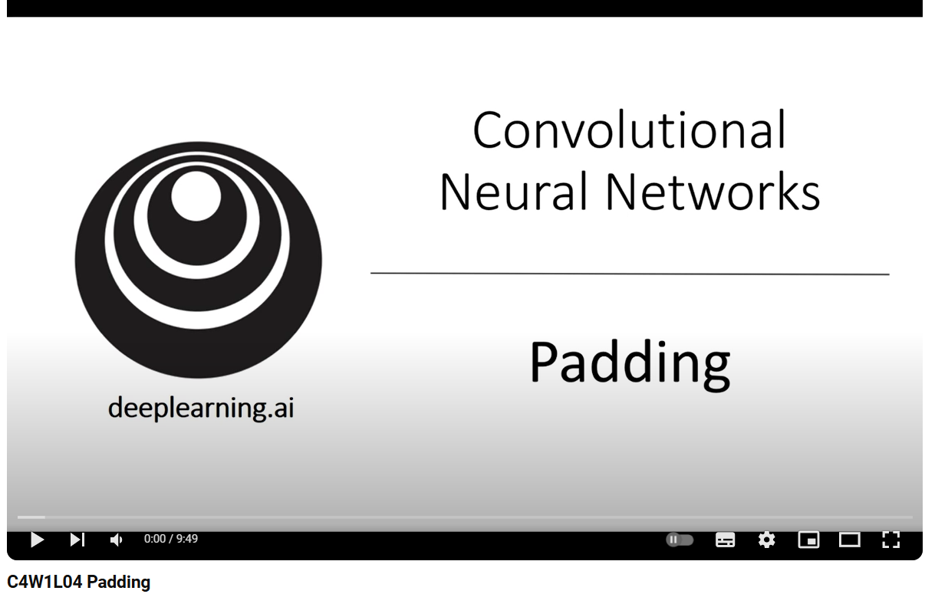
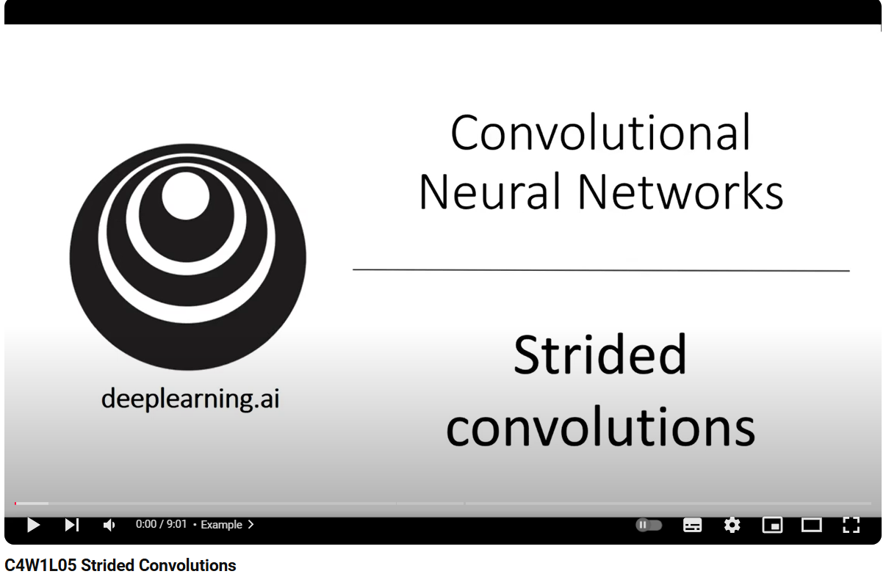

Slide 15
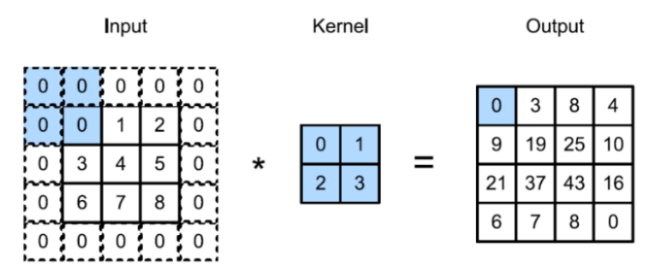
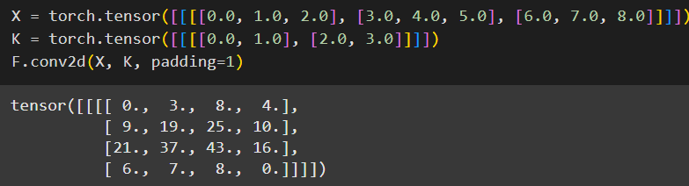

the output shape of the convolutional layer is determined by the shape of the input and the shape of the kernel
padding: addition of extra pixels around the boundary of the input image. Typically we set the values of the extra pixels to zero:
padding = 1 means that we apply 1 pixel of padding on all sides

Slide 16
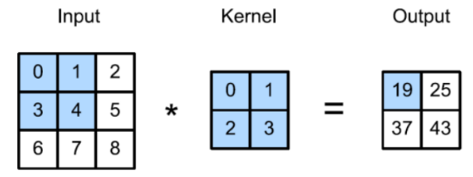
without padding:
with padding:

Slide 17
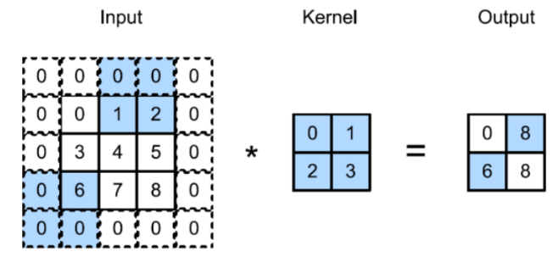
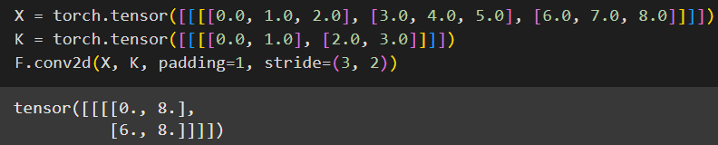

stride: the distance that the kernel moves over the input matrix:
it means that the kernel moves:
3 pixels vertically for each step
2 pixels horizontally for each step

Slide 18
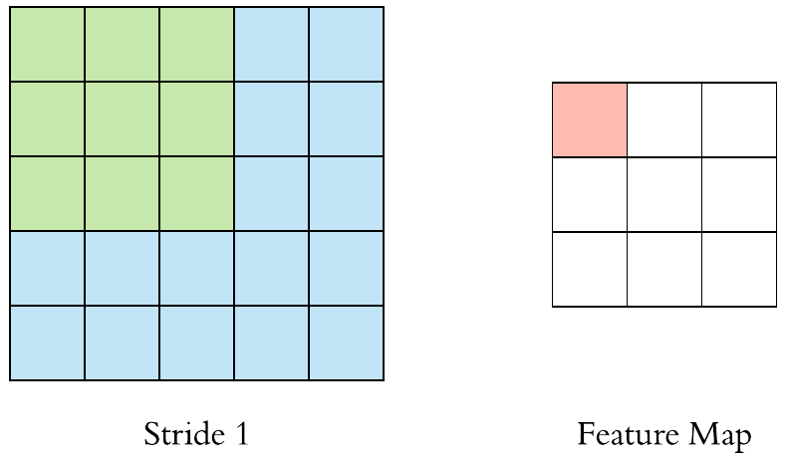
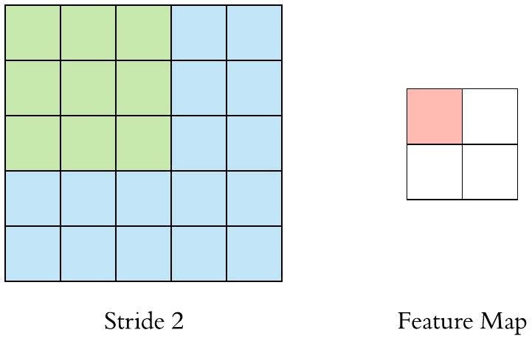
Example of stride 1 vs stride 2
it means that the kernel moves:
1 pixel vertically for each step
1 pixel horizontally for each step
it means that the kernel moves:
2 pixels vertically for each step
2 pixels horizontally for each step

Slide 19
3) Multiple input and multiple output channels

Slide 20
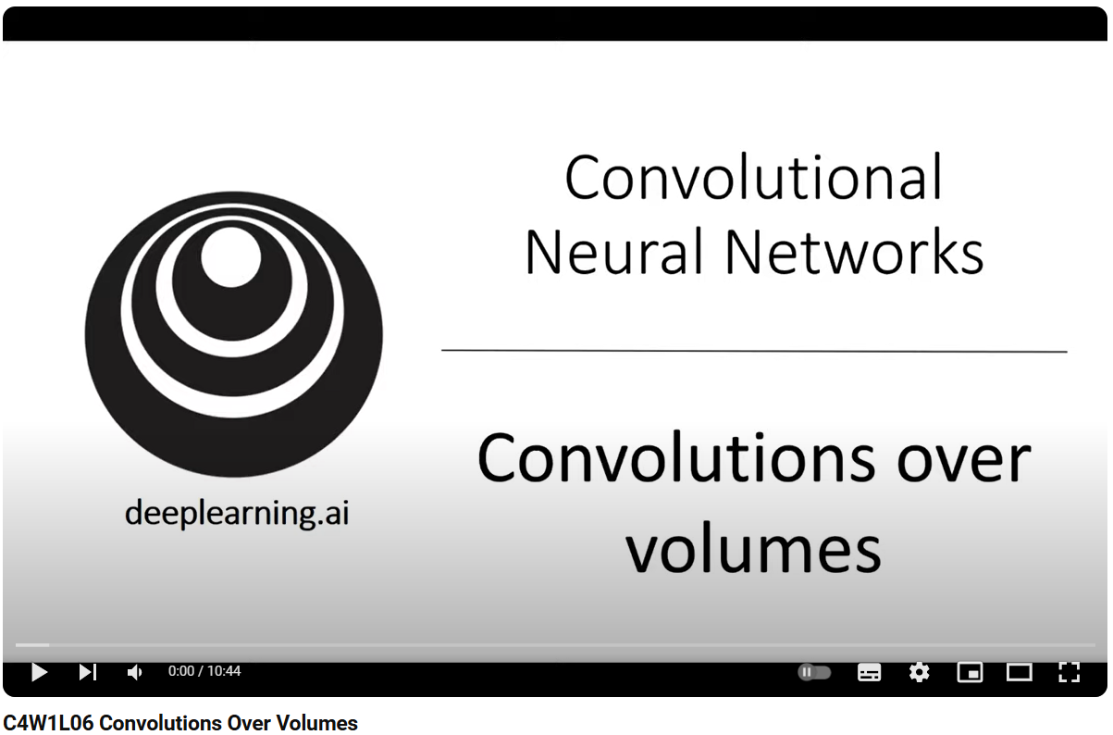

Slide 21
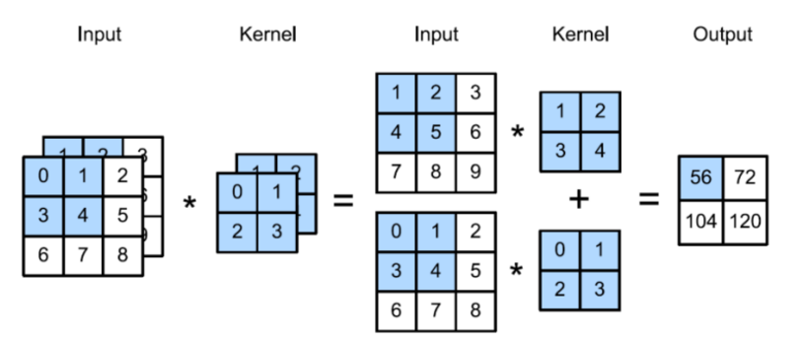
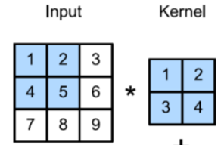

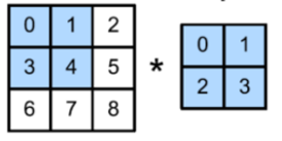
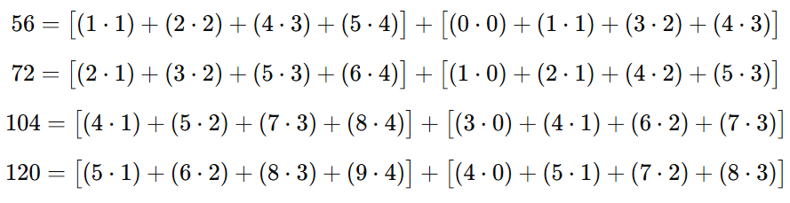
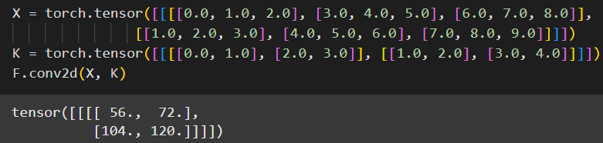

+

Slide 22


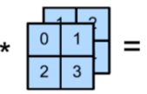


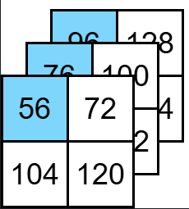



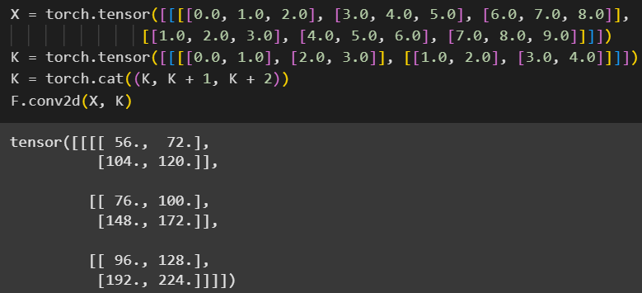







76
100
1
2
5
172
3
4
148
4
96
2
3
128
6
4
5
192
224

Slide 23
4) Pooling

Slide 24
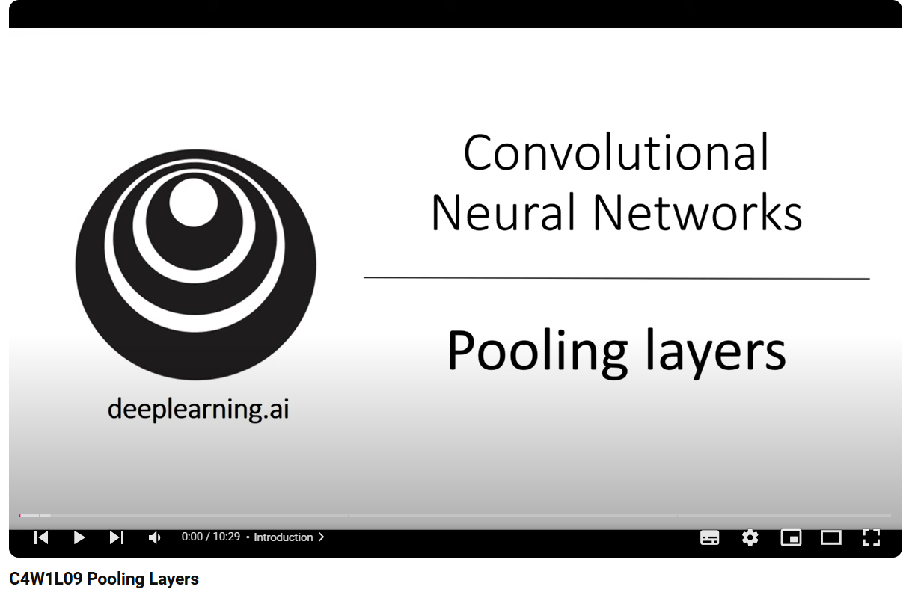

Slide 25
pooling reduces the spatial size of the feature maps
this decreases the number of parameters and computations in subsequent layers, making the network more computationally efficient
it contains no parameters (there are no learnable parameters for it)
we can have:
  Max Pooling: retains the maximum value in each region
  Average Pooling: computes the average value of all activations in each region
  etc.

Slide 26
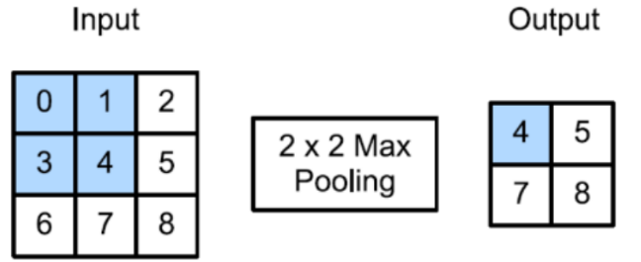
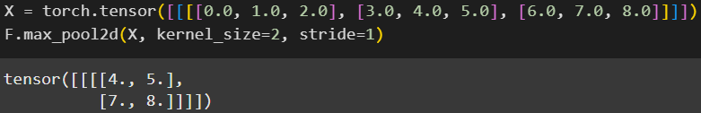
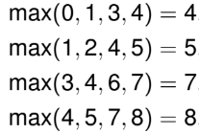
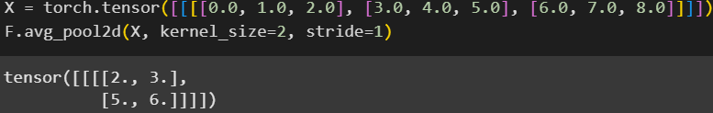
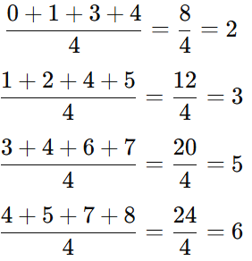

2
2x2 Average

Slide 27
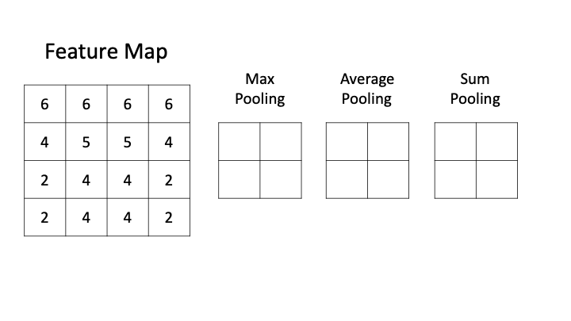















Slide 28
Benefits of using pooling layers
Dimensionality Reduction
  pooling reduces the spatial dimensions (height and width) of feature maps
  this decreases the number of parameters and computations in subsequent layers, making the network more efficient and reducing the risk of overfitting
Feature Selection
pooling layers distill the most significant features in a region, such as:
  Max Pooling: retains the strongest activations (most important features)
  Average Pooling: averages activations to provide a smoother representation
this ensures that only the most salient features are propagated further in the network

Slide 29
5) LeNet

Slide 30

LeNet or LeNet-5 is a pioneering convolutional neural network (CNN) architecture designed by Yann LeCun and his collaborators in 1998
it was originally developed for handwritten digit recognition, such as digits in ZIP codes
NOTE: you don’t need to memorize the architecture, it’s just to know that LeNet is widely recognized as the first working CNN in history
at the time of its development, deep learning and CNNs were in their beginning. There was no established set of best practices or guidelines. Yann LeCun and his team designed LeNet by trial and error, experimenting with various configurations to optimize performance for their specific task: handwritten digit recognition
“Godfather of AI”, actually Chief AI Scientist at Meta

Slide 31
What makes LeNet so special?
it was the first working CNN: introduced the world to the concept of CNNs for image recognition tasks
many core ideas in modern CNNs were first introduced or implemented in LeNet:
  convolutional layers
  pooling layers
  hierarchical feature learning: LeNet used a hierarchical approach, where lower layers learned simple features (like edges), and deeper layers combined them into more complex patterns (like shapes or digits). This hierarchical learning is a cornerstone of modern deep learning
it was one of the first neural networks to demonstrate that backpropagation and gradient-based optimization could train neural networks effectively

Slide 32
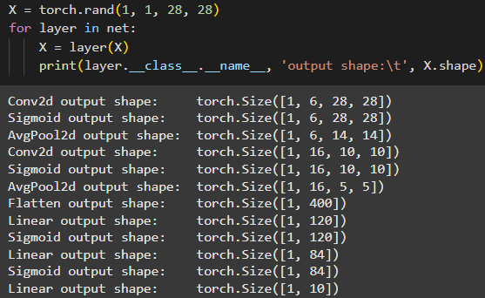
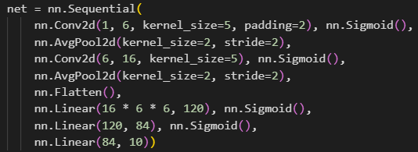
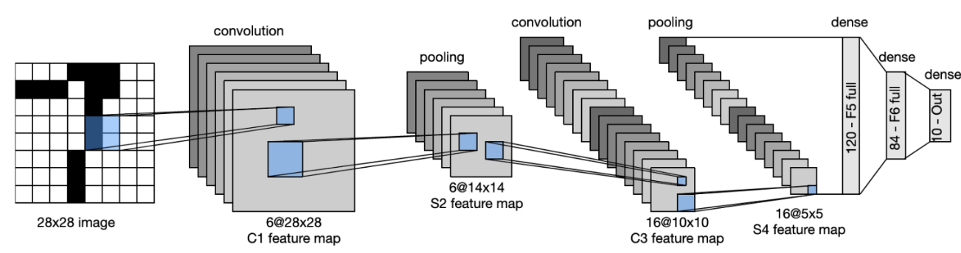


you don’t need to memorize it ☺
nn.Conv2d() + nn.Sigmoid()
nn.Conv2d() + nn.Sigmoid()
nn.Linear()
nn.AvgPool2d()
probability of being digit 0
nn.AvgPool2d()
nn.Flatten()
probability of being digit 1
probability of being digit 9

Slide 33
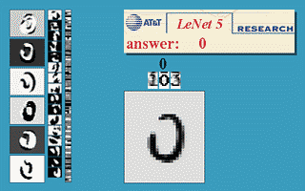

Slide 34
6) AlexNet

Slide 35


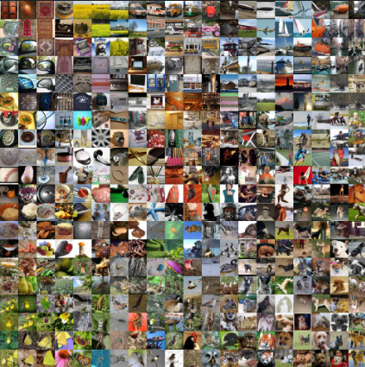
developed by Alex Krizhevsky and Geoffrey Hinton in 2012
AlexNet is a deep convolutional neural network designed to classify images into 1000 categories in the ImageNet dataset
its architecture builds on concepts from LeNet but scales them up significantly to handle the complexity of the ImageNet dataset
“Godfather of AI” together with Yann LeCun
he won the Nobel Prize in 2024
he is Alex ☺
about ImageNet:
number of images: over 14 million images
number of categories: more than 20,000 categories
image sizes: varying resolutions, with most images being of sufficient quality for recognition tasks

Slide 36
What makes AlexNet so special?
winning the ImageNet Challenge (2012): AlexNet achieved a top-5 error rate of 15.3%, significantly outperforming the second-place model (26.2%). This dramatic improvement highlighted the potential of deep learning for solving complex visual recognition tasks
it was the first architecture to successfully scale deep learning to a large dataset like ImageNet, which contains over 1.2 million high-resolution images across 1000 classes. This demonstrated that deep learning could be applied to large-scale problems effectively, given sufficient computational resources
it was the first major deep learning architecture to extensively use GPUs for training, making it feasible to train a large, deep network on the massive ImageNet dataset
AlexNet introduced or popularized several key innovations in deep learning:
  ReLU Activation Function (NOTE: LeNet was using sigmoid)
  Dropout Regularization
  Data Augmentation

Slide 37
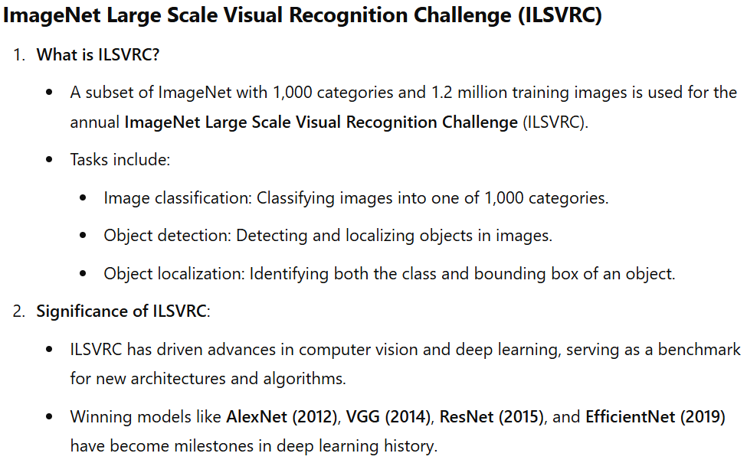

Slide 38
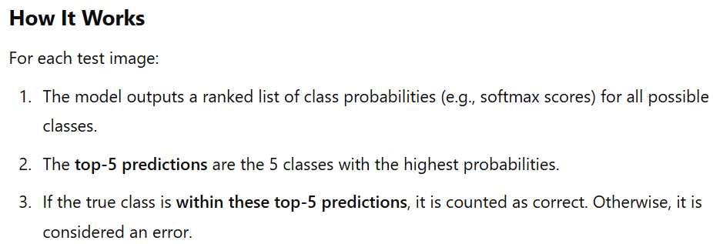
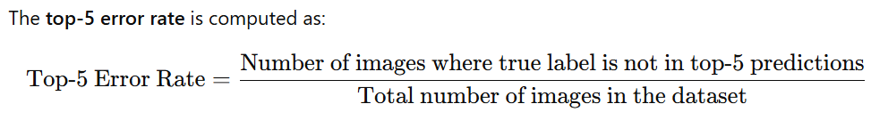


Slide 39
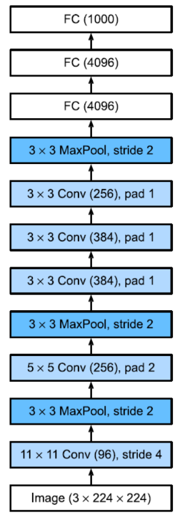
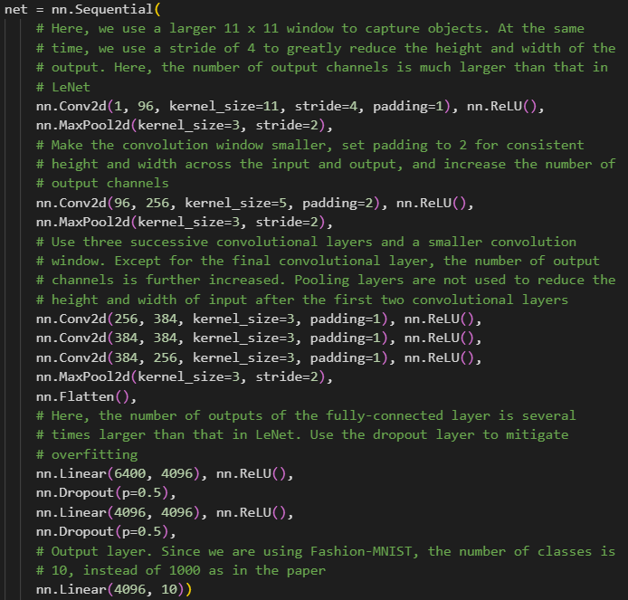
you don’t need to memorize it ☺

Slide 40
7) VGG

Slide 41
What makes VGG so special?
uniform design: VGGNet's architecture is elegant and simple, consisting of a series of stacked convolutional layers with fixed filter sizes (3×3) and pooling layers (2×2): showed that using small kernels (3×3) achieve the same or better performance than larger kernels
deep network: VGGNet explored the effects of depth in neural networks by introducing architectures with 16 and 19 layers, much deeper than predecessors like AlexNet (8 layers)
modularity: the network is built from repeating blocks of convolution and pooling, making it straightforward to extend or modify for various tasks

Slide 42
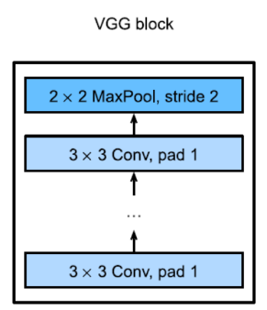
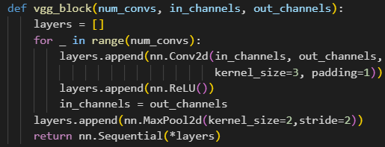
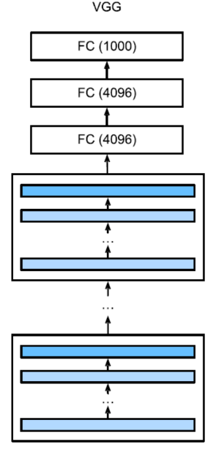
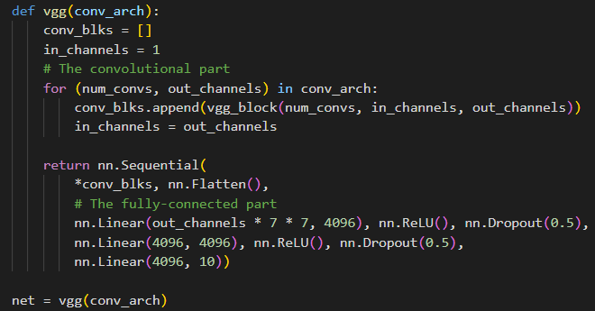


you don’t need to memorize it ☺

Slide 43
8) Batch Normalization

Slide 44
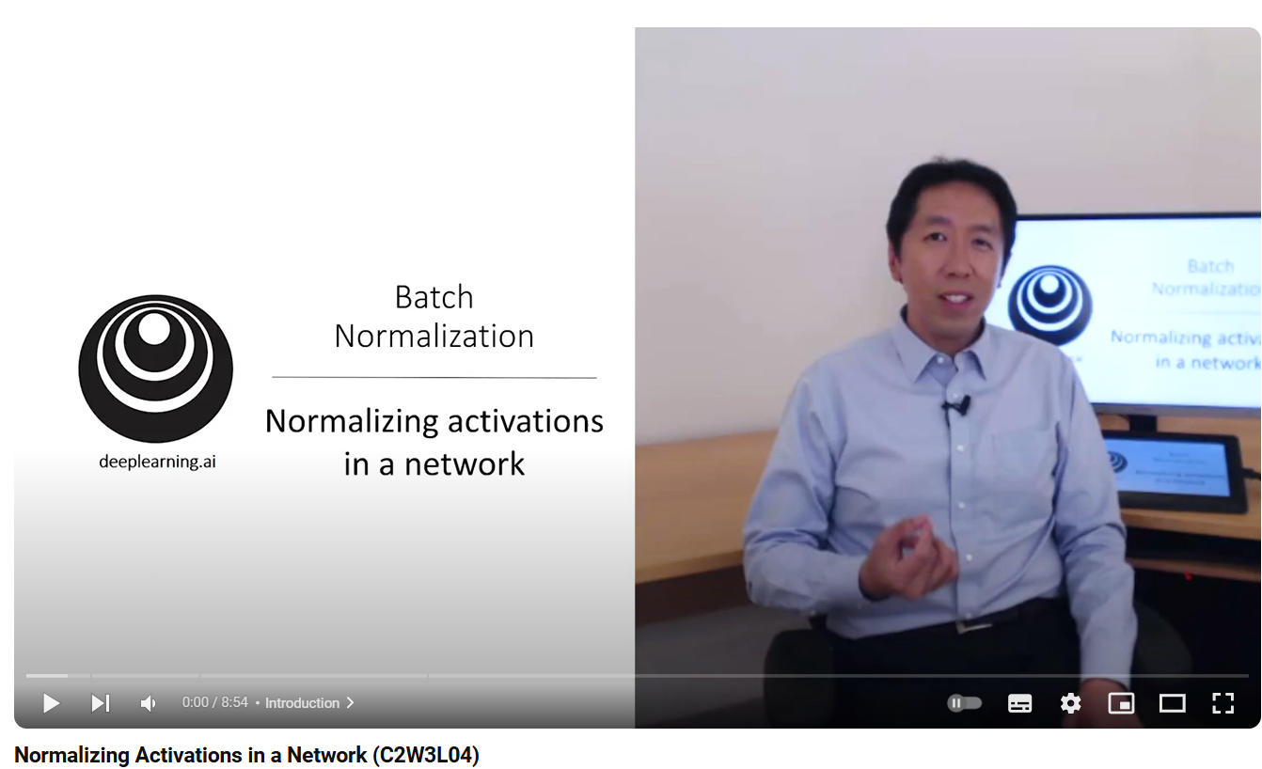


Slide 45
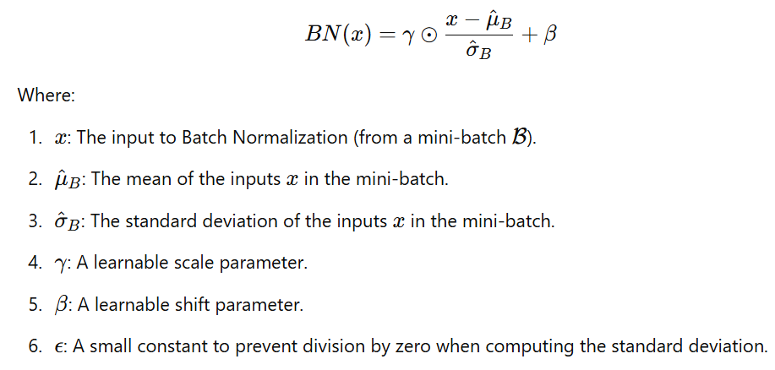
is a technique introduced to stabilize and accelerate the training of deep neural networks
is applied to individual layers (nn.Linear, nn.Conv2d) and works as follows:
  in each training iteration, we first normalize the inputs by subtracting their mean and dividing by their standard deviation, where both are estimated based on the statistics of the current mini-batch
  next, we apply a scale coefficient and a scale offset

Slide 46


Slide 47



Slide 48



NOTE: these parameters are learnable, the network learns them during training in the same way as it learns the weights w

Slide 49
Code part

Slide 50

we have 2 types of batch normalization in PyTorch:
  nn.BatchNorm2d: for batch normalization applied after convolutional layers
  nn.BatchNorm1d: for batch normalization applied after fully-connected layers
the parameter of BatchNorm represents the number of output channels of the previous layer

Slide 51
9) ResNet

Slide 52



Slide 53




introduced by Kaiming He and colleagues in 2015, is a groundbreaking DL architecture that addressed one of the major challenges in deep neural networks: the degradation problem
ResNet became famous for winning the ImageNet Large Scale Visual Recognition Challenge (ILSVRC) 2015 with a top-5 error rate of just 3.57%, surpassing human-level performance
this is the innovation

Slide 54

Degradation problem
the degradation problem in deep learning refers to a phenomenon where increasing the depth of a neural network (i.e., adding more layers) leads to worse performance on the training dataset, despite the expectation that deeper networks should perform better

Slide 55

Watch this video to understand more

Slide 56
What makes ResNet so special?
solved the degradation problem: when increasing the depth of a neural network, deeper models sometimes perform worse than shallower ones due to the difficulty in optimizing very deep networks. ResNet solved this by introducing residual connections
ResNet demonstrated that extremely deep networks (e.g., 152 layers in ResNet-152) could be trained effectively

Slide 57





this is the innovation

Slide 58





1 layer here
NOTE:
4 resnet_block, each containing 2 Residual and each Residual contains 2 layers (see previous slide – we don’t count 1x1 conv) 16 layers
1 layer here
this is known as the famous ResNet-18 – because we have 18 layers

Slide 59
Old Exercises
(same as for PI)

Slide 60


Slide 61



Solutions
you also have an example in lab ☺

Slide 62




how did I know to change them? ☺ (see next slides)

Slide 63




LeNet from the lab:
now we are working with SVHN dataset which contains RGB images (3 channels) so we need to change from 1 channel to 3 channels
next if we run the code in this form we will have an error; Why? ☺

Slide 64

originally, LeNet was developed to work with single-channel (black and white) 28x28 images
now we are working with SVHN dataset which contains RGB images of 32x32, so we need to change the number of input neurons for the first nn.Linear after nn.Flatten

Slide 65



Slide 66




use functions from this lab:
adaptation from load_data_fashion_mnist() function
I changed these

Slide 67




Slide 68





NOTE: don’t forget to change the runtime from CPU to GPU:

Slide 69




NOTE: the model is too dumb to learn this task, this is why we have so bad performance ☺

Slide 70



Optional
adaptation from get_fashion_mnist_labels() function from lab 8
function from lab 8

Slide 71

Optional
use our model to classify some images. Given a series of images, we will compare their actual labels (first line of text output) and the predictions from the model (second line of text output):
I needed to change these 2 things

Slide 72



Slide 73





NOTES
the input image (from SVHN dataset) is a color image, so I set the number of input channels for self.conv1 and self.conv2 to 3
how did I know to add padding=1 for self.conv3?
let’s do it without padding=1:
aici e buba !

Slide 74





let’s print the shapes to debug:
y3 has the (spatial) shape 28x28 and y1 has the (spatial) shape 30x30 !
we need to add some padding or stride to self.conv3 to change the spatial shape of y3 from 28x28 to 30x30
memorize this slide for the exam ☺

Slide 75

in our case:
  n_{h} = n_{w} = 30 (because y2 has the spatial shape 30x30
  k_{h} = k_{w} = 3 (because the kernel_size = 3 for self.conv3)
  p_{h} = p_{w} (because by default padding = 0 for torch.nn.Conv2d)
  s_{h} = s_{w} = 0 (because by default stride = 1 for torch.nn.Conv2d)
NOTE: if padding = 𝑝, PyTorch applies 𝑝 pixels of padding to both sides of the input (top and bottom, left and right). Therefore, the total padding added to the input along one dimension is 2 × 𝑝, so if I set padding=1, the p_{h} and p_{w} from the formula from the course will be 2
ok, next how did I know to set this number?
if we change this to 1 will solve the problem

Slide 76






Slide 77
use functions from this lab:
adaptation from load_data_fashion_mnist() function

Slide 79
NOTE: don’t forget to change the runtime from CPU to GPU:

Slide 80



NOTE: the model is too dumb to learn this task, this is why we have so bad performance ☺

Slide 81
Optional
adaptation from get_fashion_mnist_labels() function from lab 8
function from lab 8

Slide 82
Optional
use our model to classify some images. Given a series of images, we will compare their actual labels (first line of text output) and the predictions from the model (second line of text output):
I needed to change these 2 things

Slide 83
New Exercises

Slide 84


Slide 85



Solutions
How did I know that? ☺

Slide 86






memorize this slide for the exam ☺
⌊(7 – k_{h} + 2×2 + 3) / 3⌋ = 3 ⇒ k_{h} = 3
⌊(7 – k_{w} + 2×1 + 3) / 3⌋ = 2 ⇒ k_{w} = 5
in our case:
  n_{h} = n_{w} = 7
  k_{h} = ?, k_{w} = ?
  p_{h} = 2, p_{w} = 1
  s_{h} = s_{w} = 3
NOTE: if padding = 𝑝, PyTorch applies 𝑝 pixels of padding to both sides of the input (top and bottom, left and right). Therefore, the total padding added to the input along one dimension is 2 × 𝑝, so if I set padding=(2, 1), the p_{h} and p_{w} from the formula from the course will be 2×2 and 2×1
because the output shape needs to be (1, 1, 3, 2)

Slide 87





Slide 88





the input image (from SVHN dataset) is a color image, so I set the number of input channels for b1 to 3
then I applied only 2 modules of residual blocks, as specified in requirements
finally, I changed the number of input neurons for the first nn.Linear after nn.Flatten:
I looked here

Slide 89
use functions from this lab:
adaptation from load_data_fashion_mnist() function

Slide 91
NOTE: don’t forget to change the runtime from CPU to GPU:

Slide 92




Slide 93
Optional
adaptation from get_fashion_mnist_labels() function from lab 8
function from lab 8

Slide 94


Optional
use our model to classify some images. Given a series of images, we will compare their actual labels (first line of text output) and the predictions from the model (second line of text output):
I needed to change these 2 things

Slide 95



Slide 96








NOTES
the input image (from SVHN dataset) is a color image, so I set the number of input channels for self.conv3x3 to 3
how did I know to add padding=1 for self.conv3x3?
let’s do it without padding=1:
aici e buba !

Slide 97






memorize this slide for the exam ☺
⌊(n – 1 + 0 + 1) / 1⌋ = n (because by default padding = 0 and stride = 1) ⇒ the 1x1 conv leave the input shape unchanged !
we need to look at this conv to see what padding should we add; after applying the formula, padding = 1 is a good choice

Slide 98
use functions from this lab:
adaptation from load_data_fashion_mnist() function

Slide 100
NOTE: don’t forget to change the runtime from CPU to GPU:

Slide 101



NOTE: the model is too dumb to learn this task, this is why we have so bad performance ☺

Slide 102
Optional
adaptation from get_fashion_mnist_labels() function from lab 8
function from lab 8

Slide 103
Optional
use our model to classify some images. Given a series of images, we will compare their actual labels (first line of text output) and the predictions from the model (second line of text output):
I needed to change these 2 things

Slide 104
Thank you !

